Slide 1

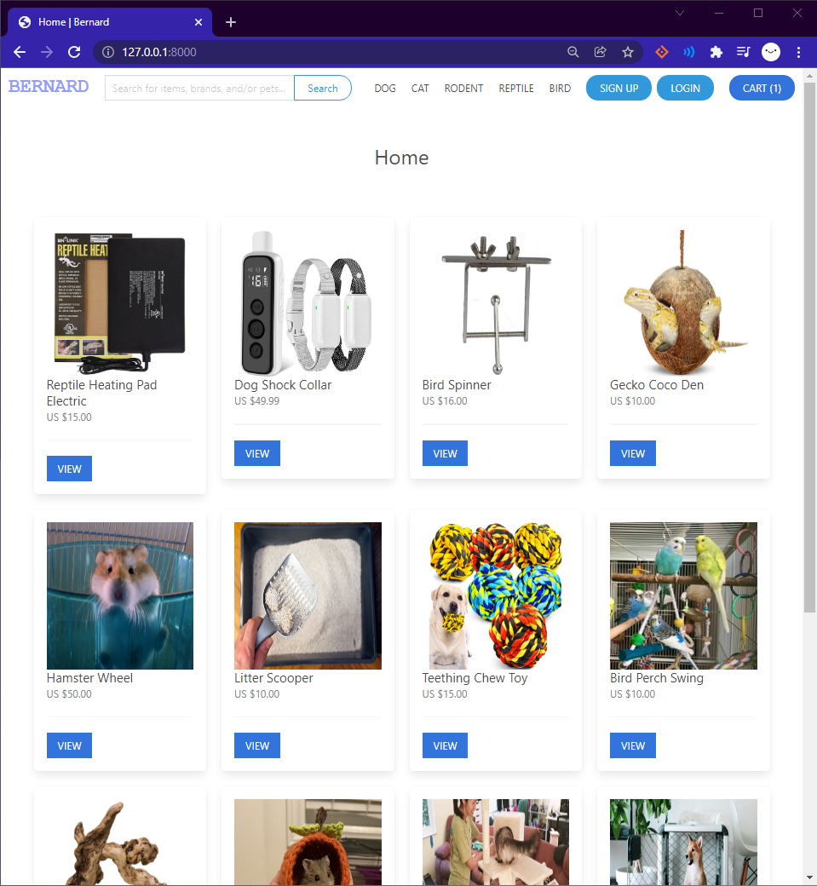
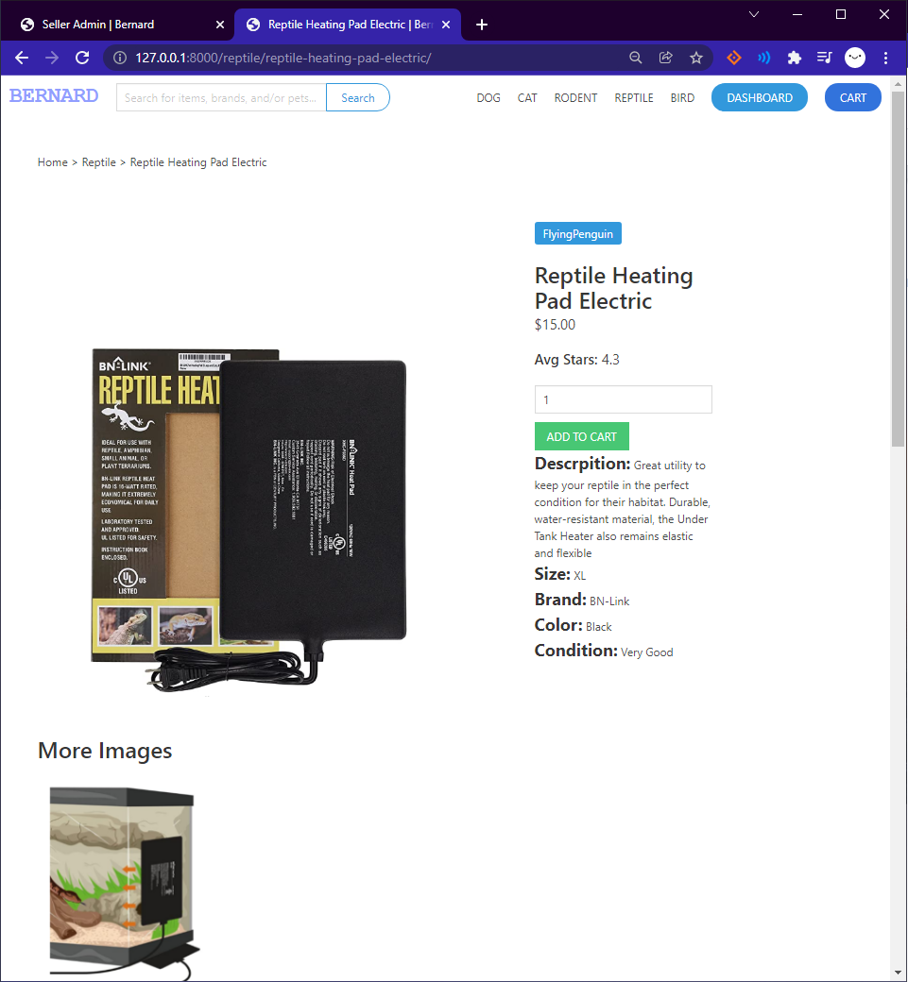
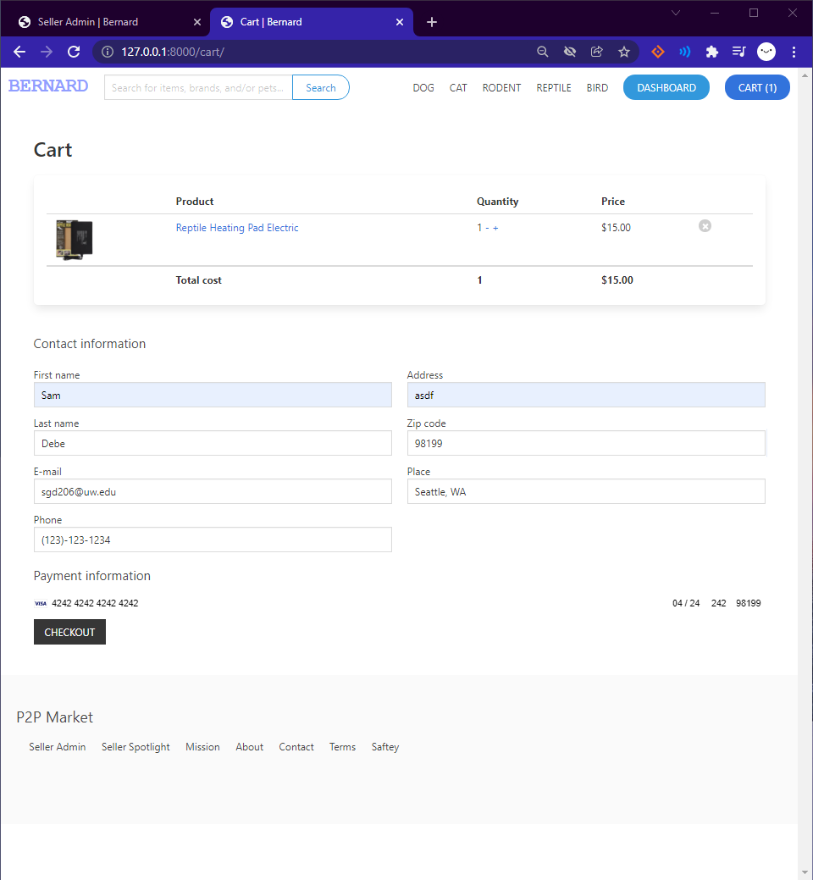
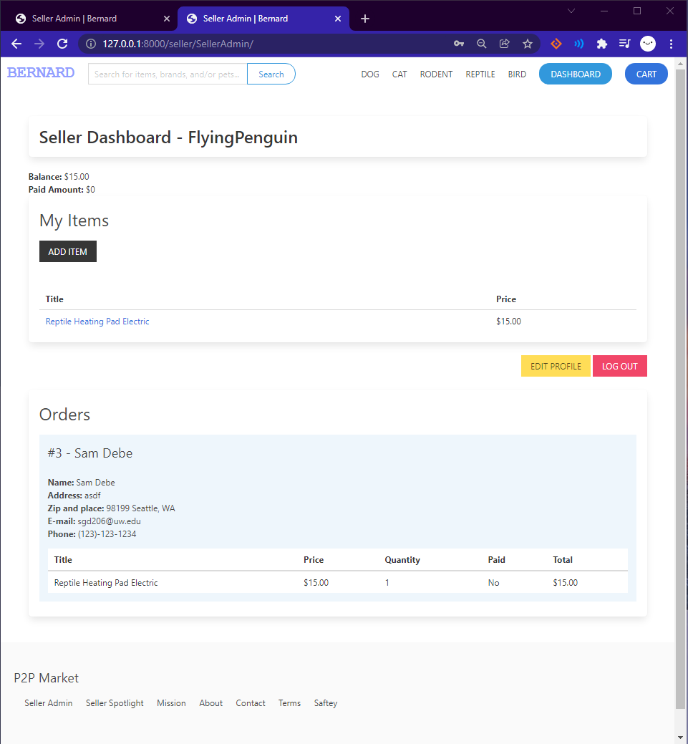





P2P Marketplace:
Model-View-Template(MVT) Architectural Design
Presenter: Samuel Debesai, CSSE | Advisor: Dr Arnold Lund | Sponsors: Mr. Mark Kochanski, Dr. Hazeline Asuncion | Quarter: Autumn 2021
Overview
Peer-2-Peer Marketplace:
online platform where individual sellers can sell used/crafted animal products to a target audience with a desired need.
Model-View-Template:
Model supports the application data
View contains the accessing of data
Template defines the structure of the model and view.
Solutions
- Functionality for Seller, Items, Orders, & Cart
- Seller Dashboard shows all of the seller’s posted items and new items ordered
Relevant Courses
CSS 342/343 - Data Struct. & Algo.
CSS 370 - Analysis & Design
CSS 480 - Principles Of Human-Computer Interaction
CSS 475 - Database Systems
CSS 461 - Software Prog. Management
Results
Conclusion
Preliminary Planning is very useful for estimating allotted time & requirements
Practicing good design helps ease of development progress
Gained more knowledge in full stack development
Objectives
Build web application that supports, maintains, and allows for users to engage with a marketplace
Use design principles to implement a functional website
Handle Buyer and Seller interactions
Future Work
Apply Business Models for revenue generation and competitive strategies
Expand Application boundaries to allow direct buyer/seller interactions on site
Port web app into a mobile app
Technologies

